Slide 1

WorkshopPLUS - Data AI: Azure SQL Database Essentials

Slide 2
Disclaimer

Slide 3

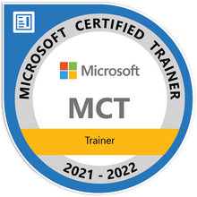
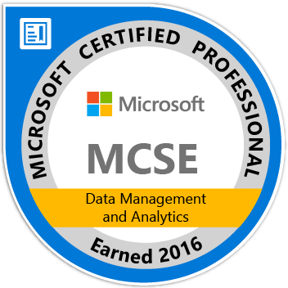
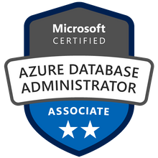



John Deardurff
Microsoft Customer Engineer (Global Technical Team)
Microsoft Certified Trainer (Regional Lead)
MVP: Data Platform (2016 – 2018)
Email: John.Deardurff@Microsoft.com
Twitter: @SQLMCT
Website: www.SQLMCT.com
GitHub: github.com\SQLMCT

Slide 4
Facilities
Class hours
Building hours
Parking
Restrooms
Meals
Phones
Messages
Recycling

Slide 5
Modules
Introduction to Azure SQL Database
Azure SQL Database Administration
Azure SQL Database Business Continuity
Manage Security for Azure SQL Database
Monitoring and Tuning Azure SQL Database
Azure SQL Database Migration & Sync Data

Slide 6
Agenda Day 1
Introduction to Azure SQL Database
Basic concepts of Azure SQL Database
Azure SQL Database Administration
Various Tools to Manage Azure SQL Database
How to create Azure SQL Database
Introduction to Elastic Database Pools in Azure SQL Database
The difference between SQL Server IaaS and PaaS Solutions
Scaling Azure SQL Databases Up and Down
Maintenance and Scheduling Jobs in Azure SQL Database
Azure SQL Database Read Scale-Out

Slide 7
Agenda Day 2
Azure SQL Database Business Continuity
Business Continuity Features in Azure SQL Database
Disaster Recovery Features in Azure SQL Database
Manage Security for Azure SQL Database
Introduction to Azure SQL Database Security
Implement Azure Active Directory Security
Manage Logins in Azure SQL Database
Implement Firewall Rules and Virtual Networks
Implement Transparent Data Encryption
Implement Always Encrypted
Implement Row Level Security
Implement Dynamic Data Masking
Implement Auditing for Azure SQL Database
Implement Advanced Data Security

Slide 8
Agenda Day 3
Monitoring and Tuning Azure SQL Database
Monitoring and Troubleshooting Azure SQL Database
Monitoring Query Performance using Query Performance Insight
Azure SQL Database Tuning using Automatic Tuning
Monitoring Azure SQL Database Performance using Intelligent Insights
Monitoring Azure SQL Database Performance using Extended Events
Configure Alerts through Azure Portal
Azure SQL Database Migration & Sync Data
Steps to migrate your database to Azure SQL Database
Is your database ready to move to Azure SQL database?
Fix database migration compatibility issues
Identify the right Azure SQL Database SKU
Migrate a compatible SQL Server database to Azure SQL Database
Sync data across multiple cloud and on-premises databases

Slide 9
Lab Times - (Minutes)
M01L02Lab01 - Create an Azure SQL Database (20)
M02L01Lab01 - Various Tools to Manage Azure SQL Database (30)
M02L02Lab01 - Scale up or down an Azure SQL Database (10)
M02L03Lab01 - Elastic Database Jobs (30)
M03L01Lab01 - Point in time restore of an Azure SQL Database (20)
M03L02Lab01 - Configure Geo Replication for an Azure SQL Database (20)
M04L06Lab01 - Implement Always Encrypted (20)
M04L07Lab01 - Implement Row Level Security (10)
M04L10Lab01 - Vulnerability Assessment (20)
M05L02Lab01 - Monitoring Query Performance using Query Performance Insights (15)
M05L05Lab01 - Monitoring Azure SQL Database Performance using Extended Events (10)
M06L05Lab01 - Migrate a Compatible SQL Server Database to Azure SQL Database (30)
M06L06Lab01 - Azure SQL Data Sync (20)

Slide 10

Attendee Introductions
Name
Job/Team/Specialty
Time Zone
Experience
Expectations

Slide 11
Connect to Lab environment
Using a web browser.
https://aka.ms/LearningCampus
Sign in with your Microsoft account not Corporate AD account
Microsoft Account (Live ID)
If you do not have one, then create it here: http://live.com
Training Key
WorkshopPLUS -> My Training (Select at the top)
Select Redeem Training Key
Enter Training Key
The training key is only need to perform the virtual labs.
The classroom will be setup through a Teams meeting

Slide 12
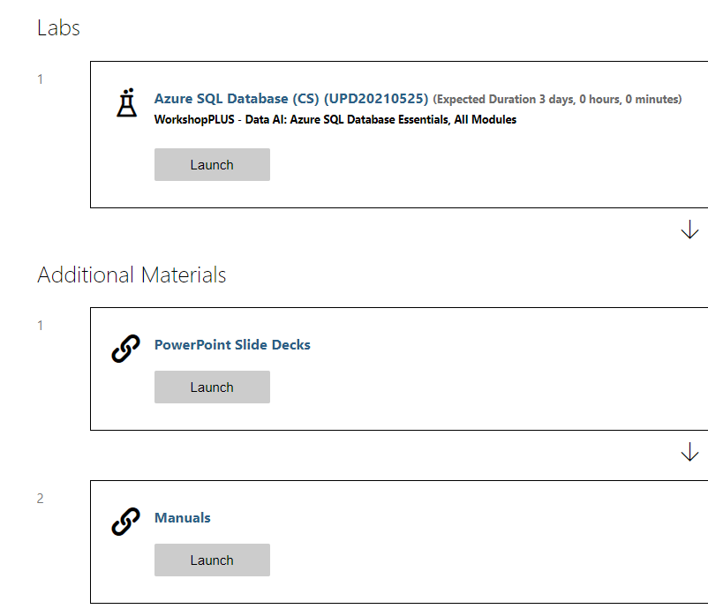
Class Resources
Virtual Lab Environment, Slides Decks, Lab Manuals, and Demo Files
In the Labs section, click Launch
Notes:
http://aka.ms/premiereducation redirects to https://mslearningcampus.com/User/Login?ReturnUrl=%2f
##########

Slide 13
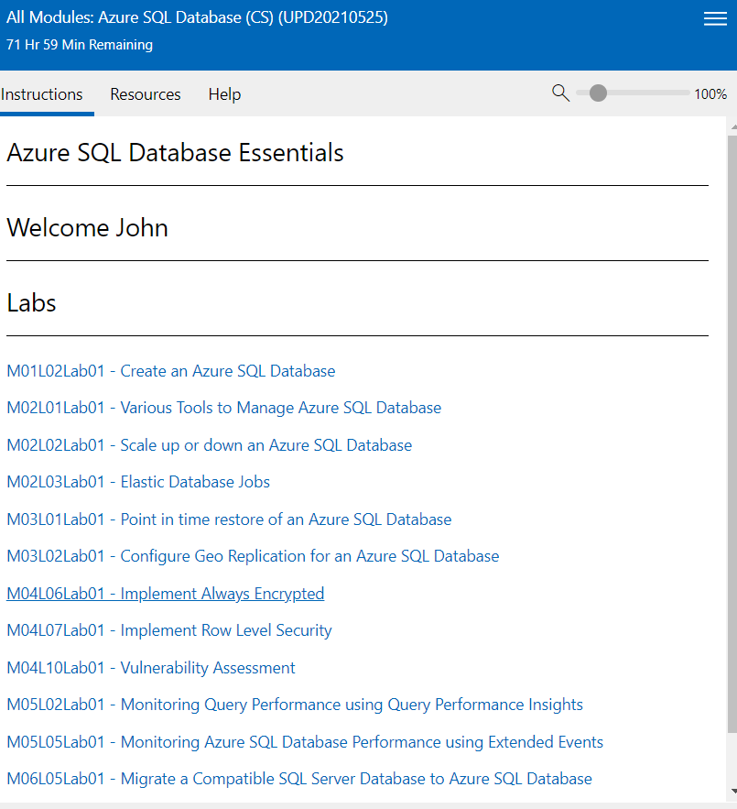
Lab environment
Lab Instructions are shown on the right side of the virtual machine.

Slide 14
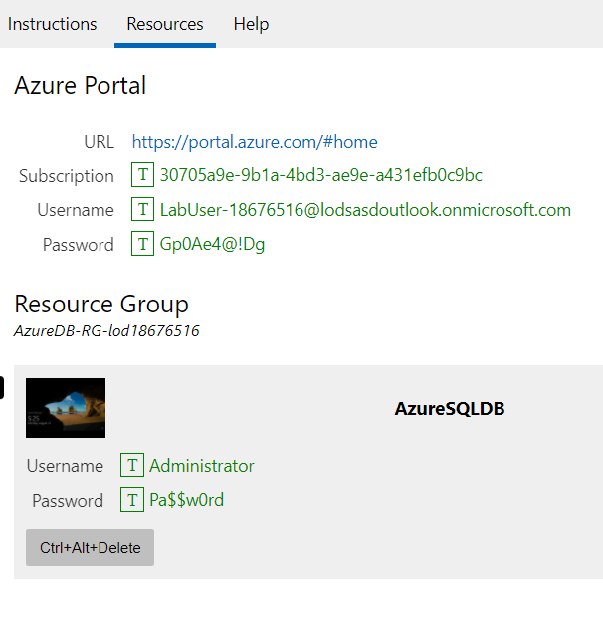
Azure Portal Environment
You must access from the Azure Virtual Machine.
Each lab has a unique Subscription, Username, and Password
You can click on the T next to Username and Password to paste in the virtual machine.

Slide 15
Virtual Machine Lab Environment
Use the Ctrl+Alt+Delete button to logon to the virtual machine.
You can click on the T next to Username and Password to paste in the virtual machine.

Slide 16
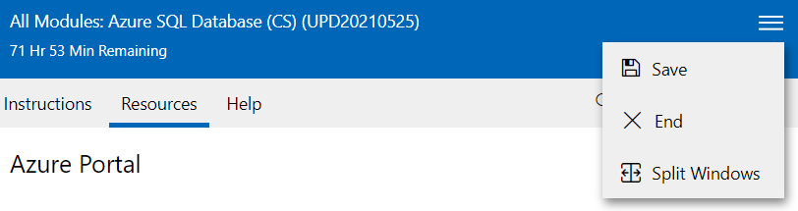
Lab Time Remaining
Select Save before leaving the Lab environment.
If you click End the lab will reset.
You can save up to 5 labs for up to 7 days.
The lab environment is available for 180 days.
Split Windows will allow you to move the instructions to a separate screen.

Slide 17
Get Ready to Participate
Close email and Update Status
Make it interactive
Check all equipment

Slide 18
Microsoft

